Slide 1
Cone Detection and Segmentation
-Pranav Pomalapally

Slide 2
1.
Fast RCCN

Slide 3
2.
Faster RCCN

Slide 4
3.
SSD

Slide 5
4.
YOLO

Slide 6
5.
OpenCV
This does not use any ML model: Computer Vision

Slide 7
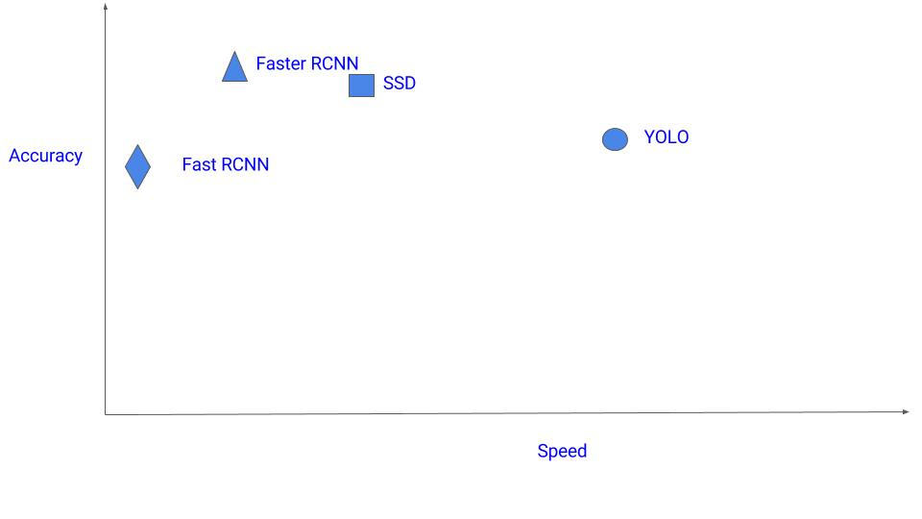
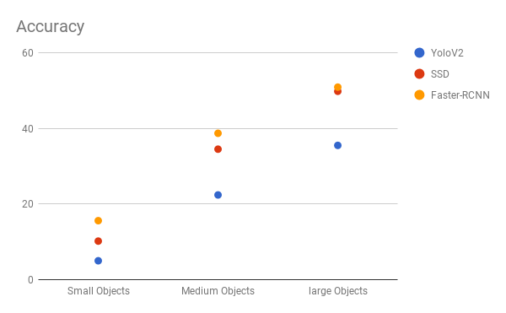
Which one is the best ???
Depends on dataset size and prioritization of accuracy and speed

Slide 8
YOLO
Fastest with most accuracy

Slide 9
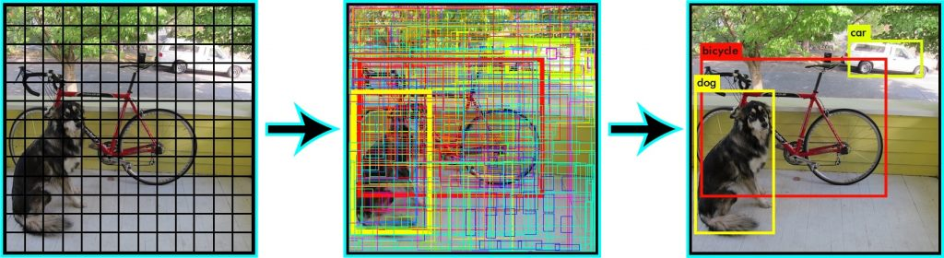
Change coordinates to yolo using labellmg
Add more data from roboflow
Split into training and test datasets

Slide 10
Dataset
Change coordinates to yolo using labellmg
Add more data from roboflow
Split into training and test datasets

Slide 11
Darknet

Slide 12
Results: Evaluation
mAP: 78.07 %
IoU threshold = 50 %
for conf_thresh = 0.25
precision = 0.87
recall = 0.59
F1-score = 0.70
TP = 205
FP = 30
FN = 143
average IoU = 62.82 %

Slide 13
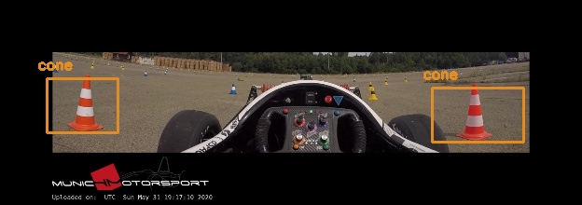
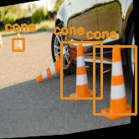
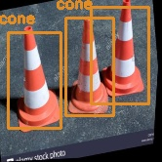
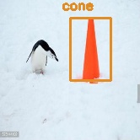
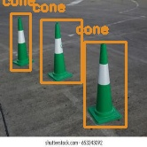
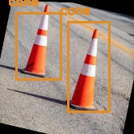
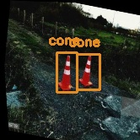
Results: Bounding Boxes
Here you have a list of items

Slide 14
Future Work
GitHub Repo: https://github.com/pranavpomalapally/ConeDetection
Augment existing data to generate more data points
Hypertune parameters
Experiment with other models specifically SSD

Slide 15
Thanks!
Any questions?

Slide 16
Credits
https://cv-tricks.com/object-detection/faster-r-cnn-yolo-ssd /Photographs by Unsplash
Data from roboflow
https://medium.com/@anirudh.s.chakravarthy/training-yolov3-on-your-custom-dataset-19a1abbdaf09
https://towardsdatascience.com/yolo-object-detection-with-opencv-and-python-21e50ac599e9
YOLO v3, darknet

